Slide 1
Rock Training 101
Introducing Rock: The church management system and database that feeds our church website
Saturday 9-Noon, March 23, 2019

Slide 2
Agenda
Thank you for coming this morning!
Clock | Time | Topic | By | For
9:00 | 15 min | Introduction | Trev | Everyone
9:15 | 60 min | Events & Registration | Jon | Office Team
10:15 | 15 min | Break
10:30 | 60 min | Groups | Jon | LifeGroups & Volunteer Central
11:30 | 30 min | Questions for Jon | Jon | Everyone
Noon |  | Release
Our Goal: Mobilize a team of people who are trained to use a vital ministry tool at Copper Hills: Our church database.

Slide 3
Introduction
9:00 – 9:15
15 min

Slide 4
Background
From the moment they start, churches must securely store related pieces of important information. And at first that’s pretty easy.
Events
Church Calendar
Website
SMALL CHURCH
Updated Manually
People
Church Directory
Church
Administrator
Money
Tithes & Offerings
“I am the good shepherd; I know my sheep and my sheep know me”
Jesus, John 10:14

Slide 5
The Problem
But as the church grows, keeping all this interconnected information up to date and synchronized by hand becomes much more difficult.
PEOPLE
EVENTS
??@#??!!
Legal/
Parental Rights
Registrations
Special
Needs
Website
Church Staff
Allergies
Kids
Check-in
Centre For
The Arts
Church
Events
Church
Directory
Church
Calendar
Sickness
& Care
Church
Communications
Small
Groups
GROWING
CHURCH!
Community Events
Volunteer Scheduling
Benevolence
Security &
Police Checks
Missions
Facility
Schedule
MONEY
Tithes &
Offerings
Hospitality
Building
Projects
Online
Giving
Equipment
Booking
FACILITIES
Fundraising
Permissions
& Paperwork

Slide 6
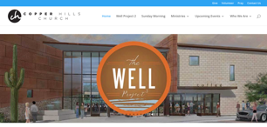
Church Management Systems
A church management system manages all this information in a big database that automatically keeps the church website up-to-date.
Website www.copperhills.org
Visitors
Church
Members
Church Staff
Registration
Communi- cations
Events &
Calendar
Events Coordinator
4 Peak Challenge
Volunteers
& Serving
People &
Directory
Facilities
Schedule
Church Office
Volunteer Central
Parents Late for Church do a mobile check-in
Kids
Check-in
Groups
Donations
& Finances
Finance
Database
Ministry
Leaders
LifeGroups
Men’s
Women’s
Youth

Slide 7
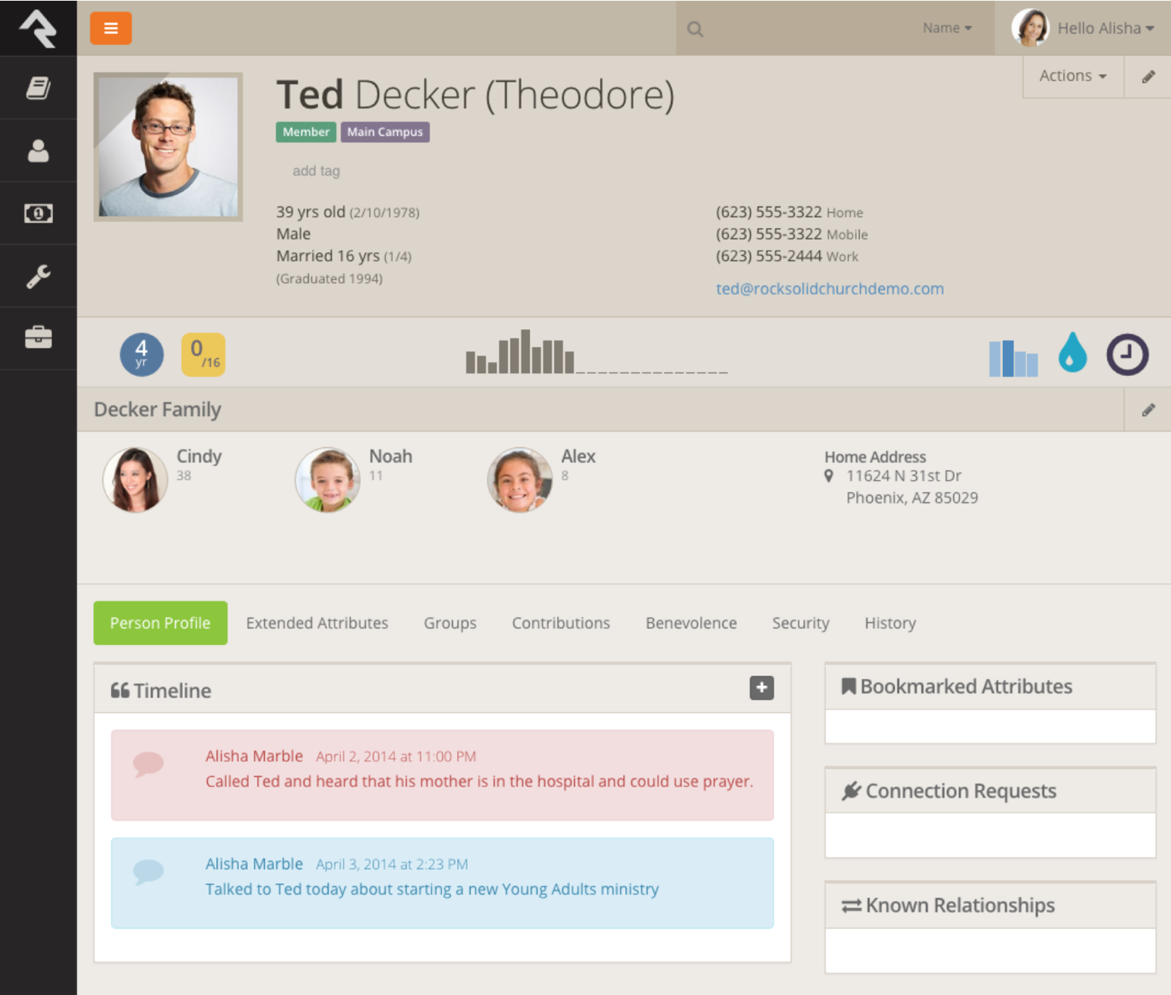
Rock Church Management System
Rock is the leading church database and much more!
Church Directory
Contact information
Involvement
Attendance & Badges
Relationships
Family and other Relationships
Groups
Small groups and serving groups
Interactions
Coordinating contact and pastoral care

Slide 8
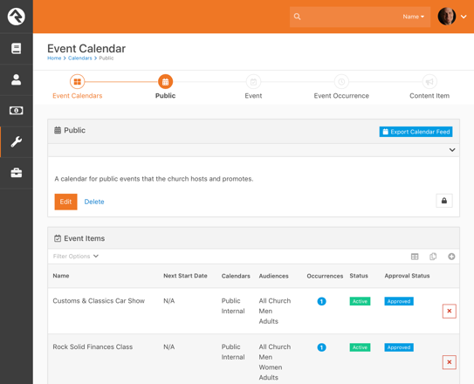
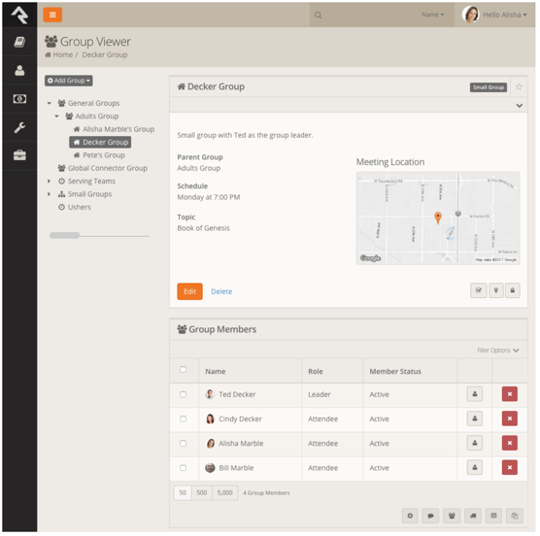
Rock-driven Website
Copper Hills new website is being developed and sits on top of Rock which automatically feeds the website with events, groups and info.
Rock Church Database
New Copperhills Website
Events
Groups

Slide 9
The Dream
As we increasingly “know our sheep” we can increasingly invite them to the best, most relevant and formative discipleship opportunities.
Doubting
Exploring
Growing
Close
Centered
Attends
Services
Matthew
Party
Visited
Service
Gift-based
Serving
Baptism
?
Car Show
Starting
Point
?
Visited
LifeGroup
Missions
Trip
Attends
LifeGroup
Women’s
Retreat
Imagine being able to offer people a customized discipleship path based on their personality, experiences and where they are currently on their journey!
= Opportunity

Slide 10
Events & Registration
9:15 – 10:15
60 min

Slide 11
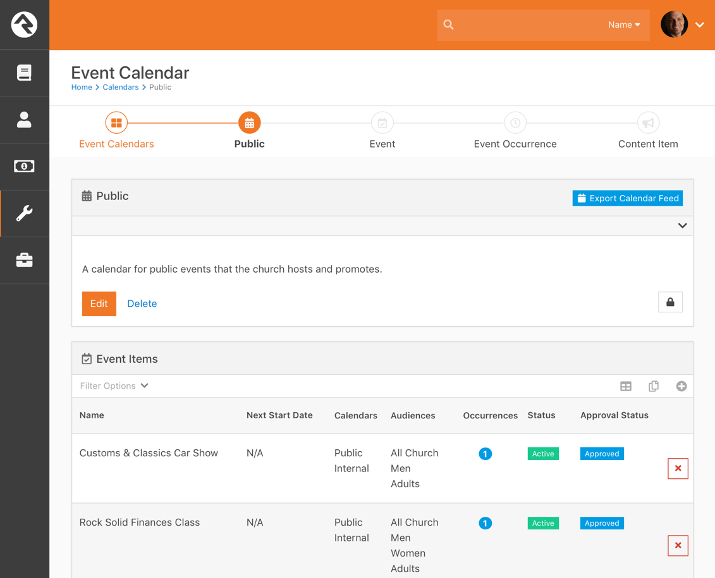
Events | Debbie & Hollianne
Rock enables us to create a database of events that automatically show on the church website at the time, to the right people.
Hands-on Demo/Walkthrough
Copper Hills Use Cases
Update a Rock Webpage Directly
Create a New Calendar Event
  Set Picture
  Set Time to Show
  Set Audience
  Set Public/Private
Update Ministry-specific Page
  Youth
  Men’s
  Women’s
Edit the Staff Landing Page

Slide 12
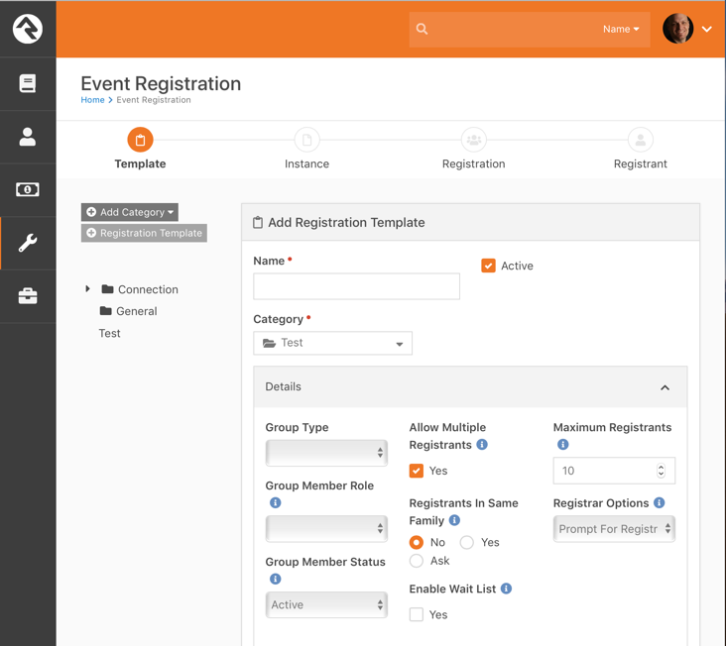

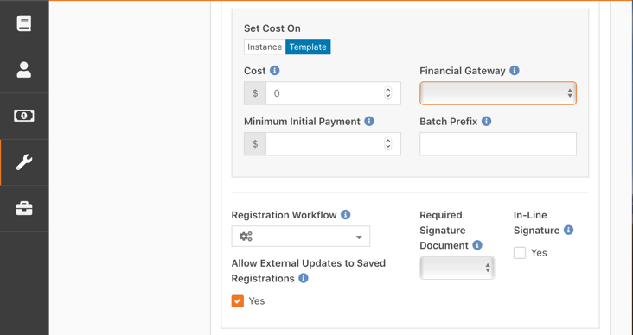
Registrations | Debbie & Hollianne
Having up-to-date information on people enables fast, accurate, online (and even mobile) registration for all kinds of events.
Hands-on Demo/Walkthrough
Copper Hills Use Cases
Set up Categories for Registrations
Set up Templates for Registrations
Online Registration
Mobile Registration
Extra Credit: Online Payments
When people register and pay for events online (lessons, retreats, paid events) our payments processor costs the church both a one-time annual fee as well as taking a percent of each transaction. In 2019 we want to try to move to a less expensive payments processor (e.g. MyWell). We need help working on this if anyone is interested.

Slide 13
Break
10:15 – 10:30
15 min

Slide 14
Groups
10:30 – 11:30
60 min

Slide 15
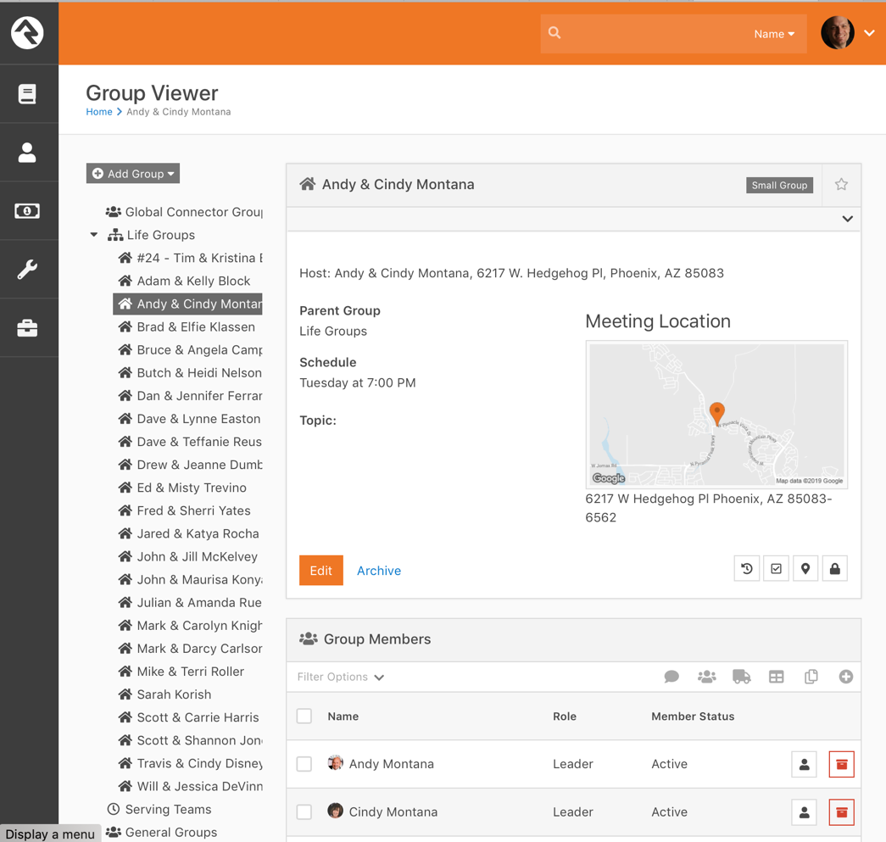
LifeGroups | Nick, Tim, Trev
Rock enables use to keep a database of all our LifeGroups, their location and demographics and show them on the church website.
Hands-on Demo/Walkthrough
Copper Hills Use Cases
Add a new LifeGroup
Update a LifeGroup
  New Time
  New Location
  New Members
How could we create a LifeGroups dashboard?
  # groups, # people, # co-leaders
  % Retirees, % Young Families
  Geographic and demographic spread?
How could we take attendance?

Slide 16
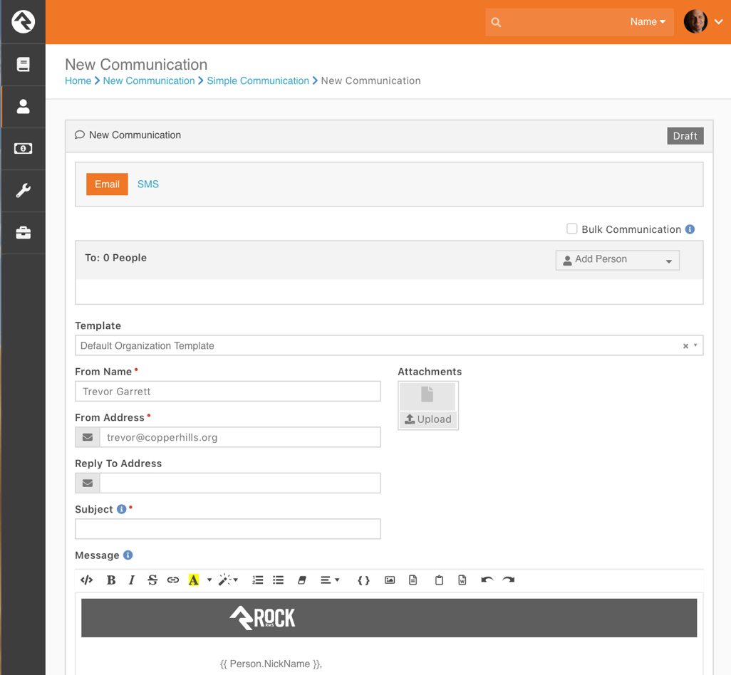
Communications | Debbie, Trev
Groups can be used for more that Small Groups ministry. Groups are also used to make administer and communicate groups of people.
Hands-on Demo/Walkthrough
Copper Hills Use Cases
Create a group of Baptism candidates
Send an email to all men in the church to help set up chairs
  By email
  Get an email response
Send a text to all parents of youth that tonight’s location for Youth Group has been changed
  Send by text
  Get responses
  Answer questions

Slide 17
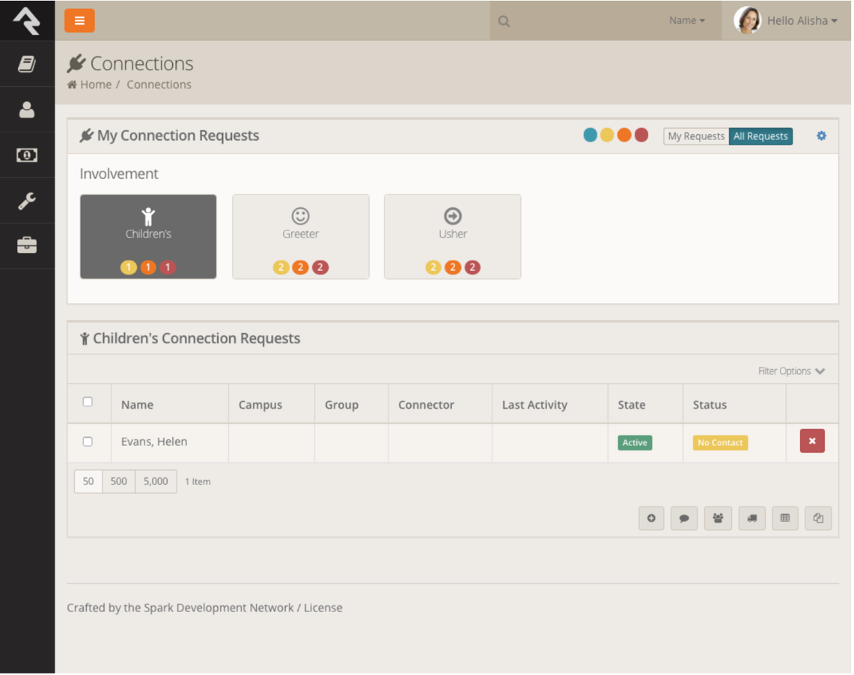
Connections | Martie, Julian, Elfie
Rock has a “Connections” capability that helps us to connect with members and coordinate follow-up done by different people.
Hands-on Demo/Walkthrough
Copper Hills Use Cases
Recruit a volunteer
  Capture info Sunday in the plaza
  Capture gift mix, skills, passions
Follow-up during the week
  By email
  By text
  By phone
Recommend a potential volunteer to a specific ministry
  e.g. Kids Ministry
  Queue them for a security check

Slide 18
Question & Answer
11:30 – 12:00
30 min

Slide 19

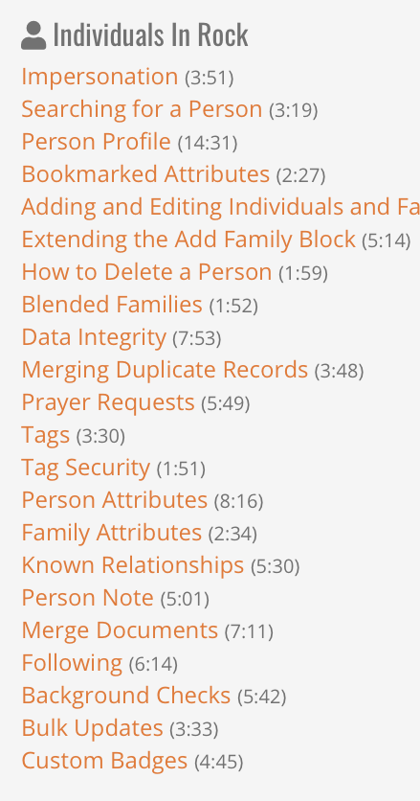
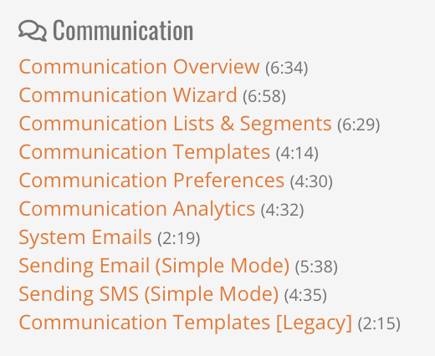
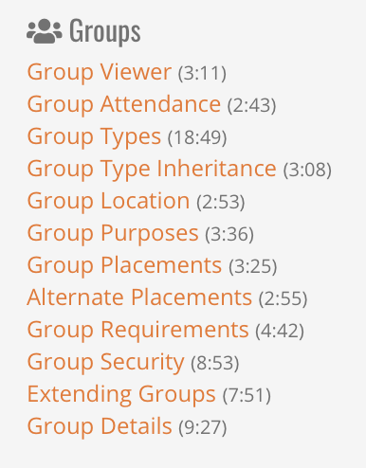
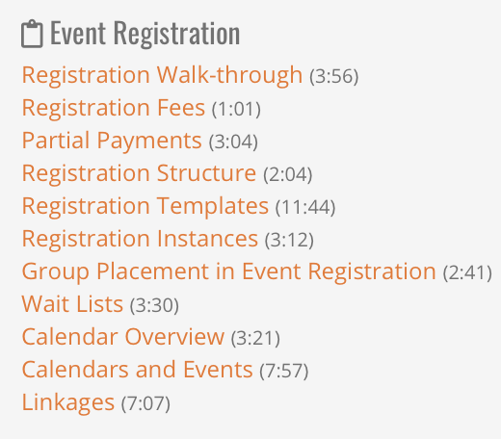
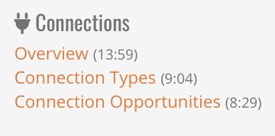
More Rock Resources
For more information, videos and manuals on using your specific corner of Rock, please consult the Rock website: www.RockRMS.com
Tons of short instructional videos at: www.rockrms.com/rocku

